Slide 1

Program Synthesis for Low-Power Accelerators
Computer Science
UC Berkeley
Ras Bodik Mangpo Phitchaya Phothilimthana Tikhon Jelvis Rohin Shah Nishant Totla

Slide 2
What we do and talk overview
Our main expertise is in program synthesis
a modern alternative/complement to compilation
Our applications of synthesis: hard-to-write code
parallel, concurrent, dynamic programming, end-user code
In this project, we explore spatial accelerators
an accelerator programming model aided by synthesis

Slide 3
Future Programmable Accelerators

Slide 4

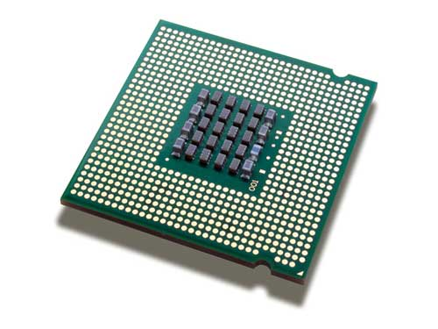


Slide 5


Slide 6




crazy ISA
small memory
back to 16-bit nums
no cache coherence
limited interconnect
no clock!
spatial & temporal partitioning

Slide 7
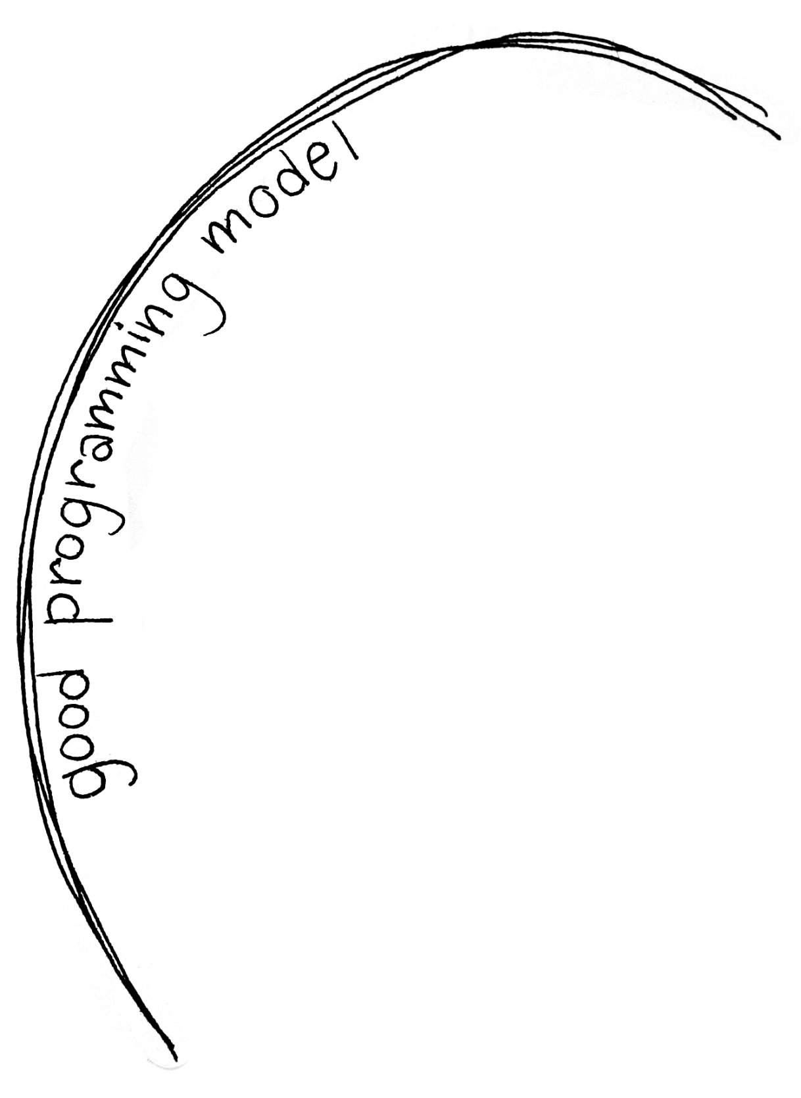
crazy ISA
small memory
back to 16-bit nums
no cache coherence
limited interconnect
no clock!
spatial & temporal partitioning

Slide 8
What we desire from programmable accelerators
We want the obvious conflicting properties:
high performance at low energy
easy to program, port, and autotune
Can’t usually get both
transistors that aid programmability burn energy
ex: cache coherence, smart interconnects, …
In principle, most decisions can be done in compilers
which would simplify the hardware
but the compiler power has proven limited

Slide 9
We ask
How to use fewer “programmability transistors”?
How should a programming framework support this?
Our approach: synthesis-aided programming model

Slide 10
GA 144: our stress-test case study

Slide 11
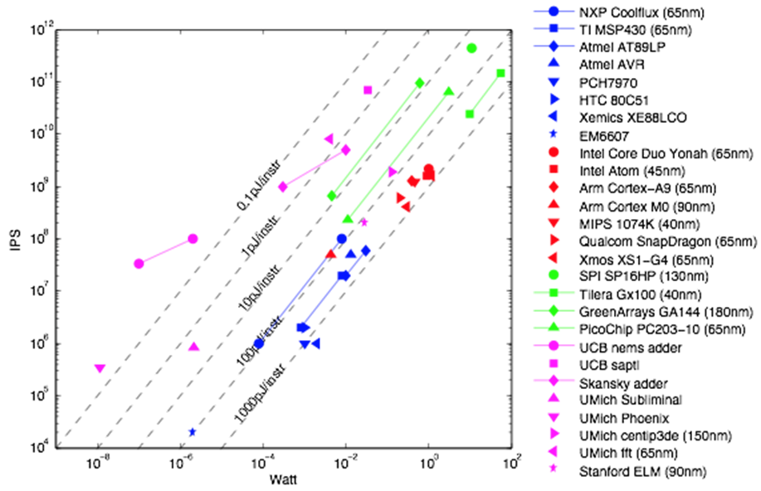
Low-Power Architectures
thanks: Per Ljung (Nokia)

Slide 12
Why is GA low power
The GA architecture uses several mechanisms to achieve ultra high energy efficiency, including:
asynchronous operation (no clock tree),
ultra compact operator encoding (4 instructions per word) to minimize fetching,
minimal operand communication using stack architecture,
optimized bitwidths and small local resources,
automatic fine-grained power gating when waiting for inter-node communication, and
node implementation minimizes communication energy.

Slide 13
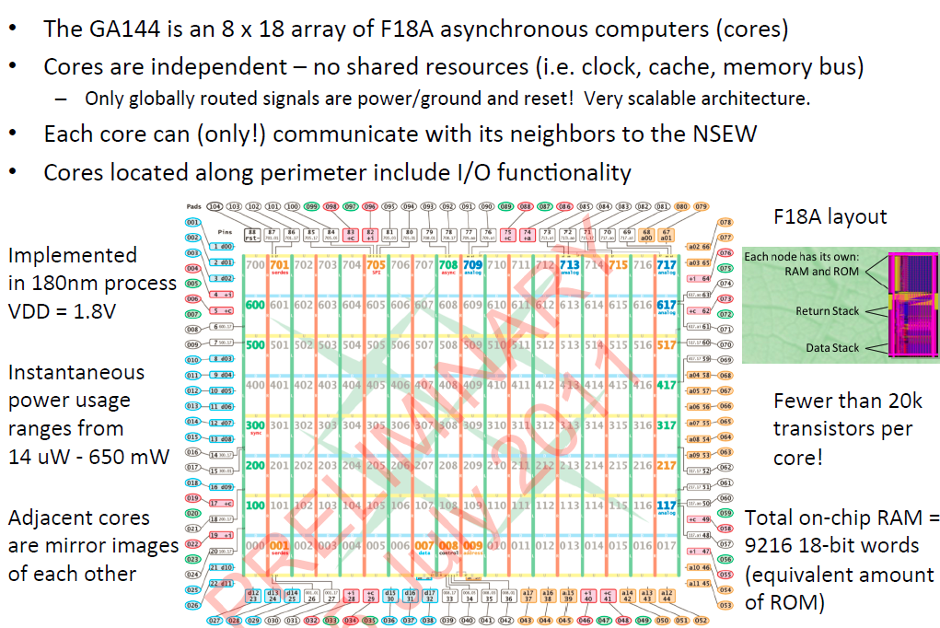
GreenArray GA144
slide from Rimas Avizienis
Notes:
Read: why so little energy?

Slide 14
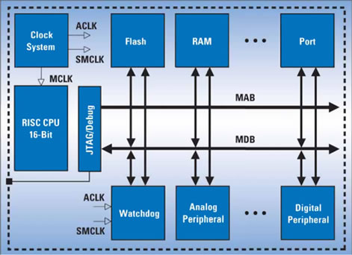
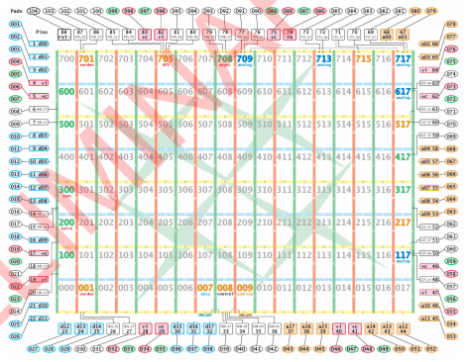
MSP430 vs GreenArray

Slide 15
Finite Impulse Response Benchmark
Performance | MSP430 (65nm) |  |  | GA144 (180nm)
 | F2274 swmult | F2617 hwmult | F2617 hwmult+dma
usec / FIR output | 688.75 | 37.125 | 24.25 | 2.18
nJ / FIR output | 2824.54 | 233.92 | 152.80 | 17.66
MSP430
GreenArrays
GreenArrays 144 is 11x faster and simultaneously 9x more energy efficient than MSP 430.
Data from Rimas Avizienis

Slide 16
How to compile to spatial architectures
Notes:
TODO: change color of these slides

Slide 17
Programming/compiling challenges
Partition the code and map it to cores
also, design the algorithm for optimal partitioning
Implement inter-core communication
don’t introduce races and deadlocks
Manage distributed data structures
for user-facing accelerators (GUIs), it’s not just arrays
Generate efficient code
often on a limited ISA
Notes:
We can remove this slide.

Slide 18
Programming/Compiling Challenges
Partition
&
Distribute
Data Structures
Algorithm/ Pseudocode
Comp1
Comp2
Comp3
Send X
Comp4
Recv Y
Comp5
Place
Schedule & Implement code
& Route Communication
Notes:
Partition the code and map it to cores
also, design the algorithm for optimal partitioning
Implement inter-core communication
don’t introduce races and deadlocks
Manage distributed data structures
for user-facing accelerators (GUIs), it’s not just arrays
Generate efficient code
often on a limited ISA

Slide 19
Existing technologies
Optimizing compilers
hard to write optimizing code transformations
FPGAs: synthesis from C
partition C code, map it and route the communication
Bluespec: synthesis from C or SystemVerilog
synthesizes HW, SW, and HW/SW interfaces

Slide 20
What does our synthesis differ?
FPGA, BlueSpec:
partition and map to minimize cost
We push synthesis further:
super-optimization: synthesize code that meets a spec
a different target: accelerator, not FPGA, not RTL
Benefits:
superoptimization: easy to port as there is no need to port code generator and the optimizer to a new ISA

Slide 21
Overview of program synthesis
Notes:
TODO: change color of these slides

Slide 22
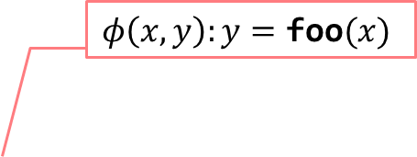
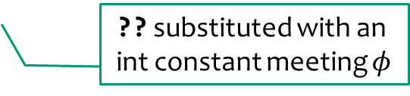
Synthesis with “sketches”
Extend your language with two constructs
spec: int foo (int x) {
return x + x;
}
$$φ\left(x,y\right):y=\text{foo}(x)$$
sketch: int bar (int x) implements foo {
return x << ??;
}
?? substituted with an int constant meeting $φ$
result: int bar (int x) implements foo {
return x << 1;
}
instead of implements, assertions over safety properties can be used
22
Notes:
Works probably for any language. This is a C/Fortan like language
Why constants suffice will become clearer in Part II

Slide 23
Example: 4x4-matrix transpose with SIMD
23
a functional (executable) specification:
int[16] transpose(int[16] M) {
int[16] T = 0;
for (int i = 0; i < 4; i++)
for (int j = 0; j < 4; j++)
T[4 * i + j] = M[4 * j + i];
return T;
}
This example comes from a Sketch grad-student contest
Notes:
what’s the goal of this example: we’ll show how to synthesize it without a big synthesizer.
clarify why matrix is linearized: gave the parallel algorithm more flexibility
4 slides + online sketch demo
show simple-to-validate executable spec
easy to define the SIMD instruction in C
show how English idea translate to a partial program
show the result
key messages:
idea-to-sketch sometimes works quite well
no domain theory on matrix transpose is needed
the search space is huge but works.
“How does the search?” motivations the next section

Slide 24
Implementation idea: parallelize with SIMD
Intel SHUFP (shuffle parallel scalars) SIMD instruction:
return = shufps(x1, x2, imm8 :: bitvector8)
x1
x2
imm8[0:1]
return
24
Notes:
TODO: show fragment of the code
refine the visual to clarify the semantics
give code of the instruction in Sketch

Slide 25
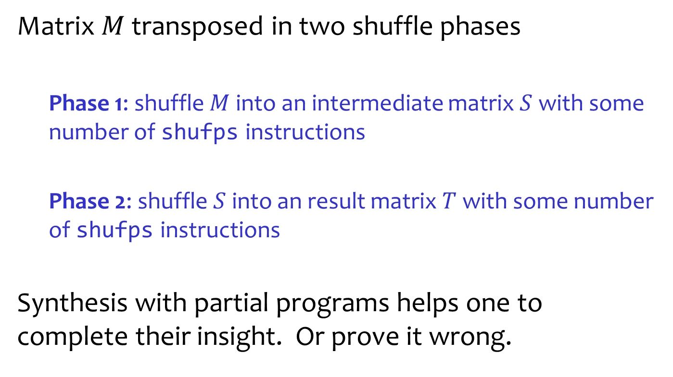
High-level insight of the algorithm designer
Matrix $M$ transposed in two shuffle phases
Phase 1: shuffle $M$ into an intermediate matrix $S$ with some number of shufps instructions
Phase 2: shuffle $S$ into an result matrix $T$ with some number of shufps instructions
Synthesis with partial programs helps one to complete their insight. Or prove it wrong.

Slide 26
The SIMD matrix transpose, sketched
int[16] trans_sse(int[16] M) implements trans {
int[16] S = 0, T = 0;
S[??::4] = shufps(M[??::4], M[??::4], ??);
S[??::4] = shufps(M[??::4], M[??::4], ??);
…
S[??::4] = shufps(M[??::4], M[??::4], ??);
T[??::4] = shufps(S[??::4], S[??::4], ??);
T[??::4] = shufps(S[??::4], S[??::4], ??);
…
T[??::4] = shufps(S[??::4], S[??::4], ??);
return T;
}
Phase 1
Phase 2
26
Notes:
1) define semantics of holes (when do you get fresh ones?)

Slide 27
The SIMD matrix transpose, sketched
int[16] trans_sse(int[16] M) implements trans {
int[16] S = 0, T = 0;
repeat (??) S[??::4] = shufps(M[??::4], M[??::4], ??);
repeat (??) T[??::4] = shufps(S[??::4], S[??::4], ??);
return T;
}
int[16] trans_sse(int[16] M) implements trans { // synthesized code
S[4::4] = shufps(M[6::4], M[2::4], 11001000b);
S[0::4] = shufps(M[11::4], M[6::4], 10010110b);
S[12::4] = shufps(M[0::4], M[2::4], 10001101b);
S[8::4] = shufps(M[8::4], M[12::4], 11010111b);
T[4::4] = shufps(S[11::4], S[1::4], 10111100b);
T[12::4] = shufps(S[3::4], S[8::4], 11000011b);
T[8::4] = shufps(S[4::4], S[9::4], 11100010b);
T[0::4] = shufps(S[12::4], S[0::4], 10110100b);
}
From the contestant email: Over the summer, I spent about 1/2 a day manually figuring it out. Synthesis time: <5 minutes.
27
Notes:
Sketch + spec --> solution

Slide 28
Demo: transpose on Sketch
Try Sketch online at http://bit.ly/sketch-language
Notes:
TODO: bring up completeness of deductive synthesis?

Slide 29
The mechanics of program synthesis (constraint solving)
Notes:
TODO: change color of these slides

Slide 30
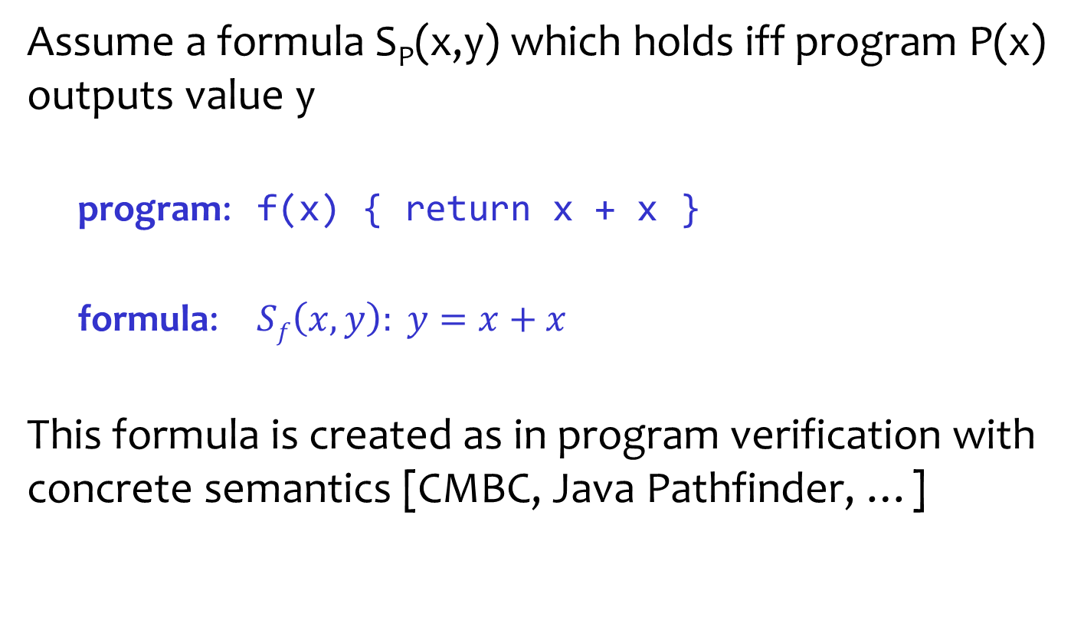
What to do with a program as a formula?
Assume a formula S_{P}(x,y) which holds iff program P(x) outputs value y
program: f(x) { return x + x }
formula: $Sf\left(x,y\right): y=x+x$
This formula is created as in program verification with concrete semantics [CMBC, Java Pathfinder, …]

Slide 31
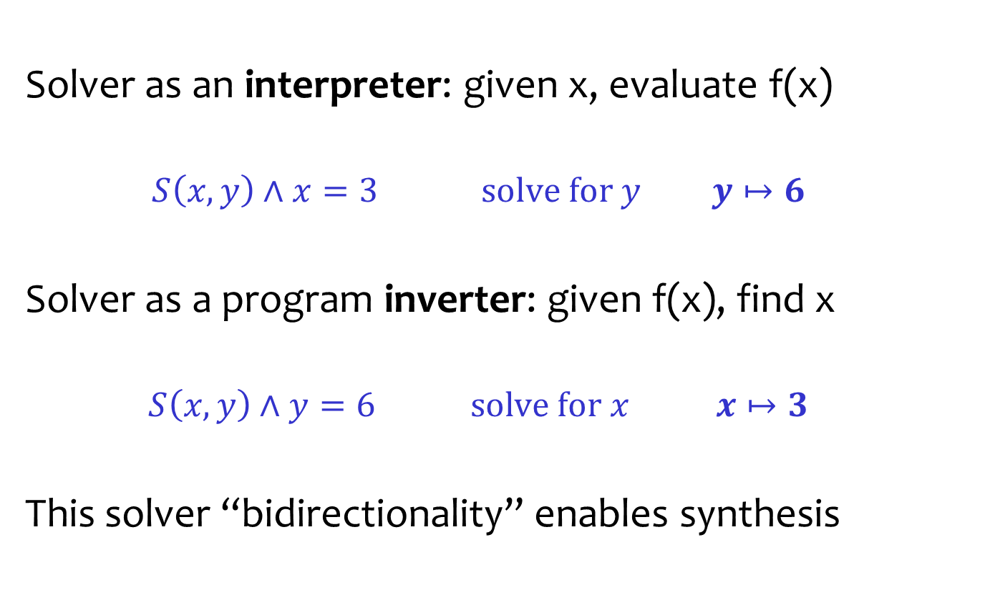
With program as a formula, solver is versatile
Solver as an interpreter: given x, evaluate f(x)
$$S\left(x,y\right)∧x=3 \text{solve} \text{for} y y↦6$$
Solver as a program inverter: given f(x), find x
$$S\left(x,y\right)∧y=6 \text{solve} \text{for} x x↦3$$
This solver “bidirectionality” enables synthesis

Slide 32
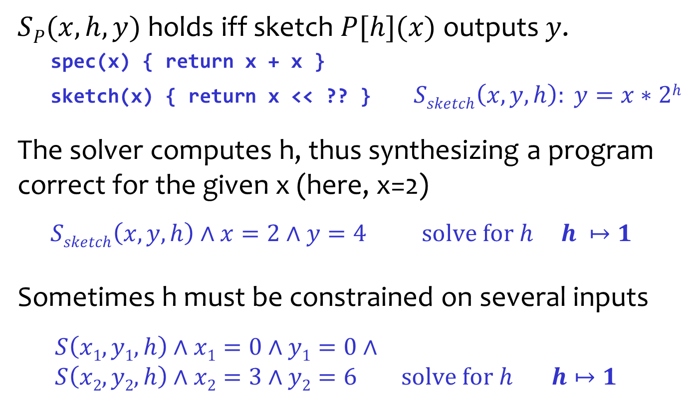
Search of candidates as constraint solving
$SP(x,h,y)$holds iff sketch $P[h](x)$outputs$y$.
spec(x) { return x + x }
sketch(x) { return x << ?? } $Ssketch\left(x,y,h\right): y=x∗2h$
The solver computes h, thus synthesizing a program correct for the given x (here, x=2)
$$Ssketch\left(x,y,h\right)∧x=2∧y=4 \text{solve} \text{for} h h ↦1$$
Sometimes h must be constrained on several inputs
$$S\left(x1,y1,h\right)∧x1=0∧y1=0∧$$
$$S\left(x2,y2,h\right)∧x2=3∧y2=6 \text{solve} \text{for} h h↦1$$
Notes:
TODO:
add solve for h
?? is represented with h
y values are computed using the spec function

Slide 33
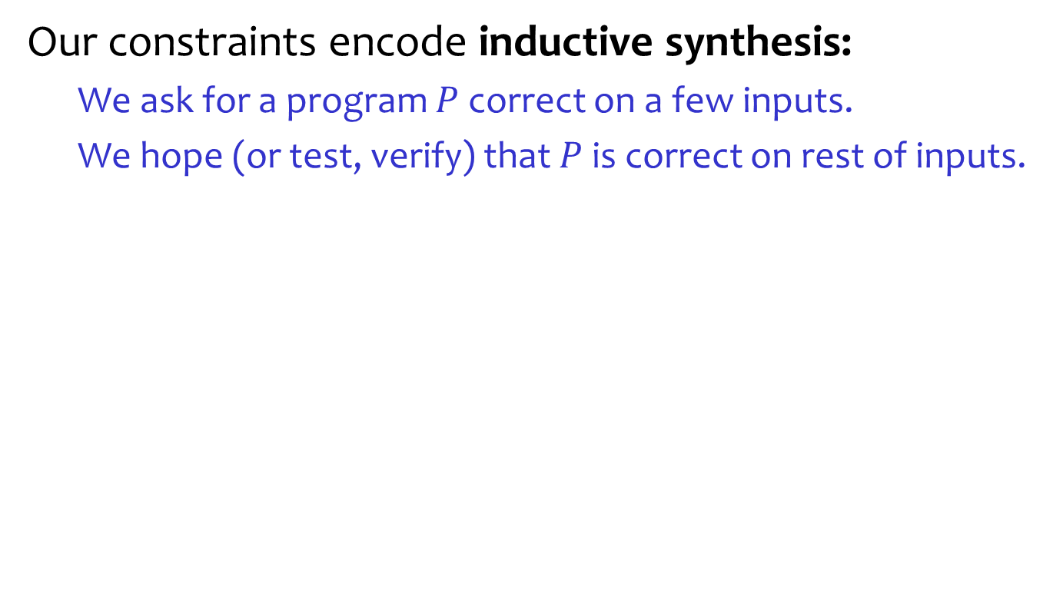
Inductive synthesis
Our constraints encode inductive synthesis:
We ask for a program $P$ correct on a few inputs.
We hope (or test, verify) that $P$ is correct on rest of inputs.

Slide 34
We propose a programming model for low-power devices by exploiting program synthesis.
Notes:
Intro sentence: now we know how synthesis works. Let look at how we apply this technique to the programmability problem of low-power devices.

Slide 35
Programming/Compiling Challenges
Partition
&
Distribute
Data Structures
Algorithm/ Pseudocode
Comp1
Comp2
Comp3
Send X
Comp4
Recv Y
Comp5
Place
Schedule & Implement code
& Route Communication
Notes:
Partition the code and map it to cores
also, design the algorithm for optimal partitioning
Implement inter-core communication
don’t introduce races and deadlocks
Manage distributed data structures
for user-facing accelerators (GUIs), it’s not just arrays
Generate efficient code
often on a limited ISA

Slide 36
Project Pipeline
Language?
Partitioning
minimize # of msgs
fit each block in a core
Language Design
expressive
flexible (easy to partition)
Comp1
Comp2
Comp3
Send X
Comp4
Recv Y
Comp5
Placement & Routing
minimize comm cost
reason about I/O pins
Intracore scheduling & Optimization
overlap comp and comm
avoid deadlock
find most energy-efficient code

Slide 37
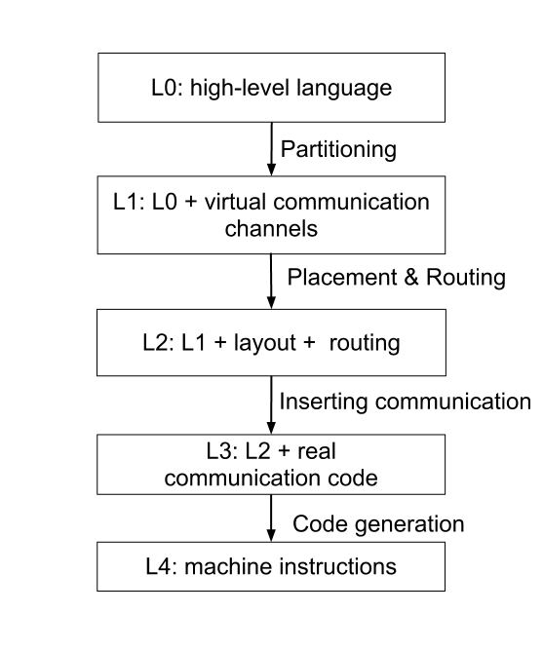
Programming model abstractions
Notes:
Goal: abstraction
Intro sentence: These are programming model abstractions that abstract the programmer away from dealing with low-level programing (dealing with machine instruction).
Sequence of talking points:
L4 & L1
Components in previous slide lower the abstraction
Conclusion: this is not up in-the-air, but we are actually working on this.
Transition sentence: but before we go into our work. Let see some case study.

Slide 38
MD5 case study
Notes:
Intro sentence: We are going to look at MD5 hash.

Slide 39
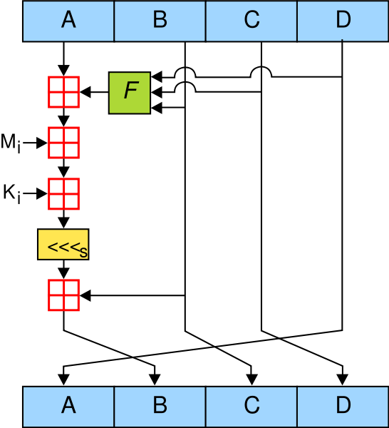
MD5 Hash
Buffer (before)
message
constant from lookup table
i^{th} round
R_{i}
Buffer (after)
Figure taken from Wikipedia
Notes:
Goal: describe md5
Intro sentence: First, I will describe how md5 function works. This diagram shows the core algorithm for md5.
Sequence of talking points:
Divide message into 16 chunks (Mi)
Each chunk of message repeat the process shown here 64 rounds

Slide 40
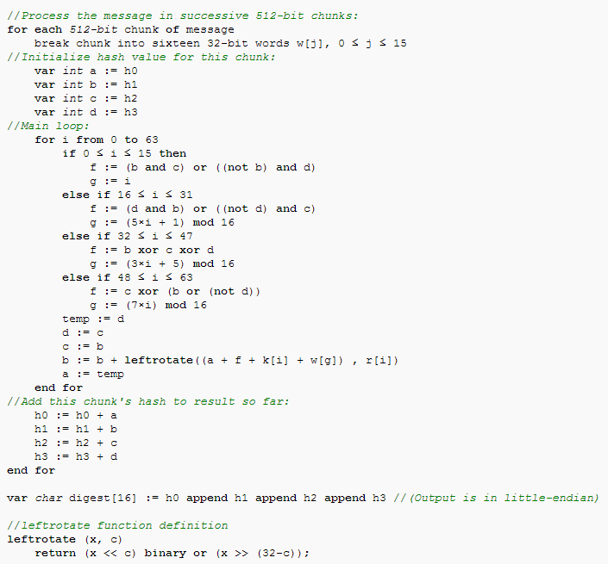
MD5 from Wikipedia
Figure taken from Wikipedia
Notes:
Goal: implemention md5 is easy
Intro sentence: This is MD5 function taken from wikipedia.
Sequence of talking points:
Seq program
Short (can fit in one page)
Conclusion: not so hard to implement
Transition sentence: what do you think it will look like when we have to implement on spatial architecture with limited resource (small memory).

Slide 41
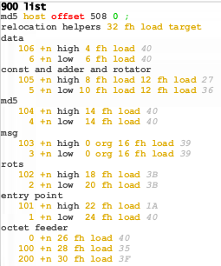
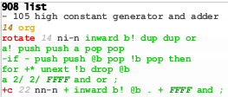
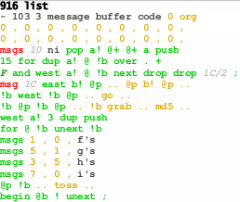
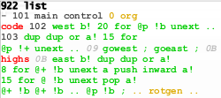
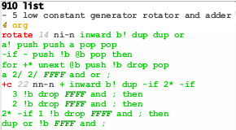
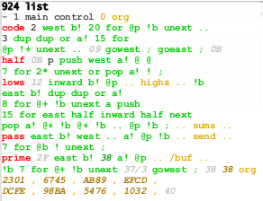
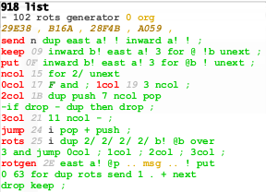
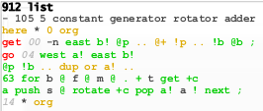
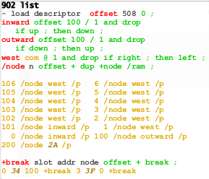
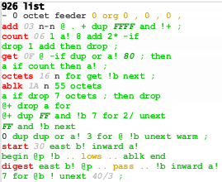
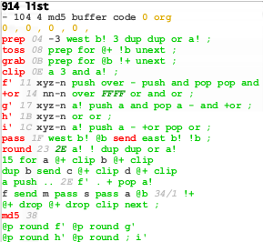
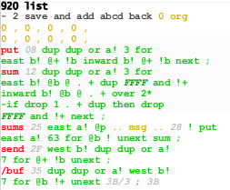
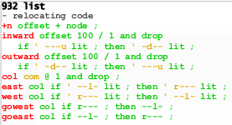
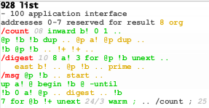
Actual MD5 Implementation on GA144

Slide 42

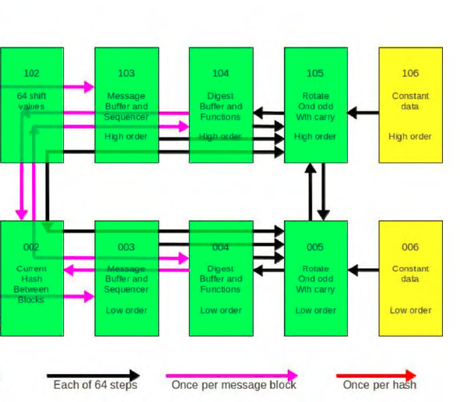
MD5 on GA144
R_{i}
102
103
104
105
106
shift value R
message M
rotate &
add with carry
constant K
High order
002
003
004
005
006
Low order
current hash
message M
rotate &
add with carry
constant K
Notes:
Goal: need to deal with partitionning
Intro sentence: On GreenArray, with its super small memory, you have to divide program into 10 pieces.

Slide 43
This is how we express MD5
Notes:
TODO: change color of these slides

Slide 44
Project Pipeline

Slide 45
Annotation at Variable Declaration
typedef pair<int,int> myInt;
vector<myInt>@{[0:16]=(103,3)} message[16];
vector<myInt>@{[0:64]=(106,6)} k[64];
vector<myInt>@{[0:4] =(104,4)} output[4];
vector<myInt>@{[0:4] =(104,4)} hash[4];
vector<int> @{[0:64]=102} r[64];
106
@core indicates where data lives.
high order
k[i]
6
low order
Notes:
Goal: look like C with annotation
Intro sentence: start with variable declaration.
Sequence of talking points:
Very similar to C
With annotation for placement on core
Pair of “18” bit int
Transition sentence: what about the rest of the program?

Slide 46
Annotation in Program
(104,4) is home for md5()function
void@(104,4) md5() {
for(myInt@any t = 0; t < 16; t++) {
myInt@here a = hash[0], b = hash[1], c = hash[2], d = hash[3];
for(myInt@any i = 0; i < 64; i++) {
myInt@here temp = d;
d = c;
c = b;
b = round(a, b, c, d, i);
a = temp;
}
hash[0] += a;
hash[1] += b;
hash[2] += c;
hash[3] += d;
}
output[0] = hash[0];
output[1] = hash[1];
output[2] = hash[2];
output[3] = hash[3];
}
@any suggests that any core can have this variable.
@here refers to the function’s home @(104,4)
Notes:
Goal: look very like the spec
Intro sentence: without the annotation in blue, this looks essentially like seq code from wikipedia
Sequence of talking points:
We can actually take this and run on your laptop
@
Home = a convenient way to refer it
Conclusion: can debug easily
Transition sentence: I mention how to specify the core that data lives. What about operation?

Slide 47
MD5 in CPart
typedef pair<int,int> myInt;
vector<myInt>@{[0:64]=(106,6)} k[64];
myInt@(105,5) sumrotate(myInt@(104,4) buffer, ...) {
myInt@h sum = buffer +@here k[i] + message[g];
...
}
Notes:
Goal: show op@
Intro sentence: let look at different parts of md5
Sequence of talking points:
We can actually take this and run on your laptop
@
Home = a convenient way to refer it
Conclusion: can debug easily
Transition sentence: I mention how to specify the core that data lives. What about operation?

Slide 48
MD5 in CPart
typedef pair<int,int> myInt;
vector<myInt>@{[0:64]=(106,6)} k[64];
myInt@(105,5) sumrotate(myInt@(104,4) buffer, ...) {
myInt@h sum = buffer +@here k[i] + message[g];
...
}
buffer is at (104,4)
104
high order
buffer
4
low order

Slide 49
MD5 in CPart
typedef pair<int,int> myInt;
vector<myInt>@{[0:64]=(106,6)} k[64];
myInt@(105,5) sumrotate(myInt@(104,4) buffer, ...) {
myInt@h sum = buffer +@here k[i] + message[g];
...
}
k[i] is at (106,6)
106
high order
k[i]
6
low order

Slide 50
MD5 in CPart
typedef pair<int,int> myInt;
vector<myInt>@{[0:64]=(106,6)} k[64];
myInt@(105,5) sumrotate(myInt@(104,4) buffer, ...) {
myInt@h sum = buffer +@here k[i] + message[g];
...
}
+ is at (105,5)
105
+
high order
5
+
low order

Slide 51
MD5 in CPart
typedef pair<int,int> myInt;
vector<myInt>@{[0:64]=(106,6)} k[64];
myInt@(105,5) sumrotate(myInt@(104,4) buffer, ...) {
myInt@h sum = buffer +@here k[i] + message[g];
...
}
buffer is at (104,4)
+ is at (105,5)
k[i] is at (106,6)
Implicit communication in source program.
Communication inserted by synthesizer.
104
105
106
+
high order
buffer
k[i]
4
5
6
+
low order
Notes:
Transition sentence: what if do don’t like this layout? It’s actually really easy.

Slide 52
MD5 in CPart
typedef pair<int,int> myInt;
vector<myInt>@{[0:64]=(205,105)} k[64];
myInt@(204,5) sumrotate(myInt@(104,4) buffer, ...) {
myInt@h sum = buffer +@here k[i] + message[g];
...
}
buffer is at (104,4)
+ is at (204,5)
k[i] is at (205,105)
204
205
+
high order
k[i]
104
105
buffer
4
5
+
low order
Notes:
Transition sentence: what if you deal with 64 bit number?

Slide 53
MD5 in CPart
typedef vector<int> myInt;
vector<myInt>@{[0:64]={306,206,106,6}} k[64];
myInt@{305,205,105,5} sumrotate(myInt@{304,204,104,4} buffer, ...) {
myInt@h sum = buffer +@here k[i] + message[g];
...
}
buffer is at {304,204,104,4}
+ is at {305,205,105,5}
k[i] is at {306,206,106,6}
304
305
306
buffer
+
k[i]
204
205
206
+
104
105
106
+
4
5
6
+
Notes:
Transition sentence: let look at the rest of the expression now.

Slide 54
MD5 in CPart
typedef pair<int,int> myInt;
vector<myInt>@{[0:64]=(106,6)} k[64];
myInt@(105,5) sumrotate(myInt@(104,4) buffer, ...) {
myInt@h sum = buffer +@here k[i] + message[g];
...
}

Slide 55
MD5 in CPart
typedef pair<int,int> myInt;
vector<myInt>@{[0:64]=(106,6)} k[64];
myInt@(105,5) sumrotate(myInt@(104,4) buffer, ...) {
myInt@h sum = buffer +@here k[i] +@?? message[g];
...
}
+ happens at here which is (105,5)
+ happens at where the synthesizer decides

Slide 56
Summary: Language & Compiler
Language features:
Specify code and data placement by annotation
No explicit communication required
Option to not specifying place
Synthesizer fills in holes such that:
number of messages is minimized
code can fit in each core

Slide 57
Project Pipeline
Notes:
Intro sentence: beside the HLL, I have also been working on another component of the project.

Slide 58
Program Synthesis for Code Generation
Synthesizing optimal code
Input: unoptimized code (the spec)
Search space of all programs
Synthesizing optimal library code
Input: sketch + spec
Search completions of the sketch
Synthesizing communication code
Input: program with virtual channels
Insert actual communication code

Slide 59
1) Synthesizing optimal code
unoptimized code (spec)
slower
synthesizer
faster
optimal code

Slide 60
Our Experiment
naive
hand
spec
slower
bit trick
synthesizer
faster
optimized
most optimal
Register-based processor
Stack-based processor

Slide 61
Our Experiment
naive
hand
spec
slower
bit trick
synthesizer
faster
optimized
most optimal
Register-based processor
Stack-based processor

Slide 62
Comparison
naive
hand
spec
slower
bit trick
synthesizer
translation
hand
faster
optimized
most optimal
Register-based processor
Stack-based processor

Slide 63
Preliminary Synthesis Times
Synthesizing a program with
8 unknown instructions
takes 5 second to 5 minutes
Synthesizing a program up to
~25 unknown instructions
within 50 minutes

Slide 64
Preliminary Results
Program | Description | Approx. Speedup | Code length reduction
x – (x & y) | Exclude common bits | 5.2x | 4x
~(x – y) | Negate difference | 2.3x | 2x
x | y | Inclusive or | 1.8x | 1.8x
(x + 7) & -8 | Round up to multiple of 8 | 1.7x | 1.8x
(x & m) | (y & ~m) | Replace x with y where bits of m are 1’s | 2x | 2x
(y & m) | (x & ~m) | Replace y with x where bits of m are 1’s | 2.6x | 2.6x
x’ = (x & m) | (y & ~m) y’ = (y & m) | (x & ~m) | Swap x and y where bits of m are 1’s | 2x | 2x
Notes:
64

Slide 65
Code Length
Program | Original Length | Output Length
x – (x & y) | 8 | 2
~(x – y) | 8 | 4
x | y | 27 | 15
(x + 7) & -8 | 9 | 5
(x & m) | (y & ~m) | 22 | 11
(y & m) | (x & ~m) | 21 | 8
x’ = (x & m) | (y & ~m) y’ = (y & m) | (x & ~m) | 43 | 21
Notes:
65

Slide 66
2) Synthesizing optimal library code
Input:
Sketch: program with holes to be filled
Spec: program in any programing language
Output:
Complete program with filled holes

Slide 67
Example: Integer Division by Constant
Naïve Implementation:
Subtract divisor until reminder < divisor.
# of iterations = output value Inefficient!
Better Implementation:
n - input
M - “magic” number
s - shifting value
M and s depend on the number of bits and constant divisor.
quotient = (M * n) >> s
Notes:
67

Slide 68
Example: Integer Division by 3
Spec:
n/3
Sketch:
quotient = (?? * n) >> ??
Notes:
68

Slide 69
Preliminary Results
Program | Solution | Synthesis Time (s) | Verification Time (s) | # of Pairs
x/3 | (43691 * x) >> 17 | 2.3 | 7.6 | 4
x/5 | (209716 * x) >> 20 | 3 | 8.6 | 6
x/6 | (43691 * x) >> 18 | 3.3 | 6.6 | 6
x/7 | (149797 * x) >> 20 | 2 | 5.5 | 3
deBruijn: Log₂x (x is power of 2) | deBruijn = 46, Table = {7, 0, 1, 3, 6, 2, 5, 4} | 3.8 | N/A | 8
Note: these programs work for 18-bit number except Log2x is for 8-bit number.
Notes:
69

Slide 70
3) Communication Code for GreenArray
Synthesize communication code between nodes
Interleave communication code with computational code such that
There is no deadlock.
The runtime or energy comsumption of the synthesized program is minimized.

Slide 71
The key to the success of low-power computing lies in inventing better and more effective programming frameworks.
Notes:
Due to the lack of hardware support for programmability, the key to the success of low-power computing
lies in inventing better and more effective programming frameworks for such devices, allowing the programmer
to write efficient programs with reasonable amount of effort and time.

